Slide 1
Amphibian Presence Prediction
Jerry Ngo

Slide 2
Intro
Based on satellite information on amphibian appearance, give prediction on the occurrence of amphibian based on the site’s attribute.
Applying model like decision tree, support vector machine, artificial neural network on the data set.

Slide 3
Data Set

Slide 4
Data Set Information
Was prepared for the environmental impact assessment reports for two planned road in Poland.
Gives the amphibian population with 189 occurence sites along with 16 attributes of each site.
7 amphibian species

Slide 5
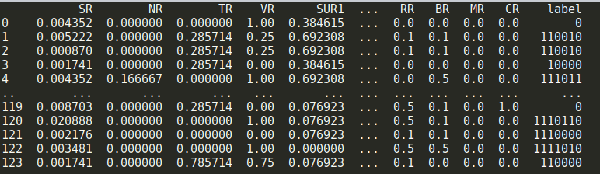
Data Set Preprocess
Data is well collected and presented
Apply min-max normalization
Select attribute for training
Concatenate label
Split training and validation set

Slide 6
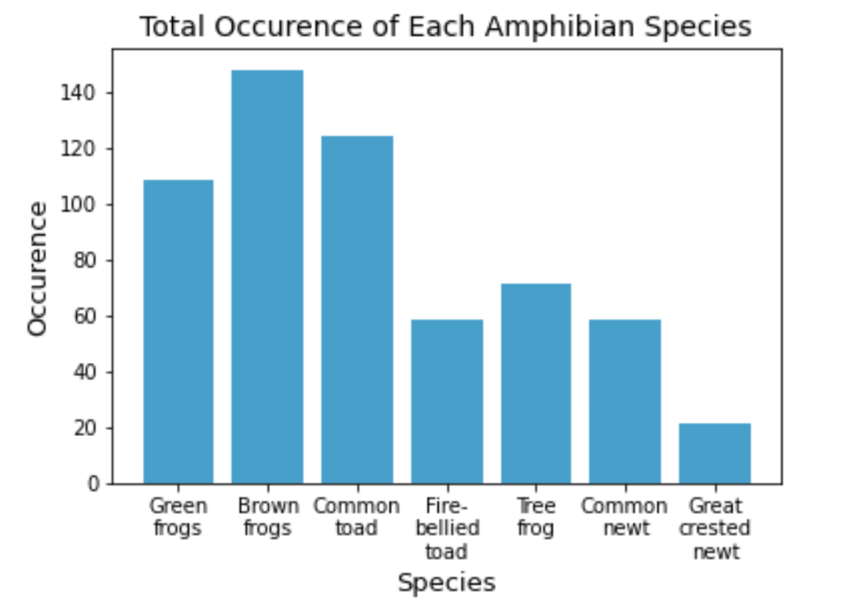
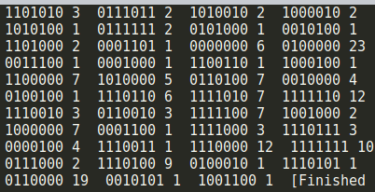
Data Set Analyzation
Distribution is not evenly distributed

Slide 7
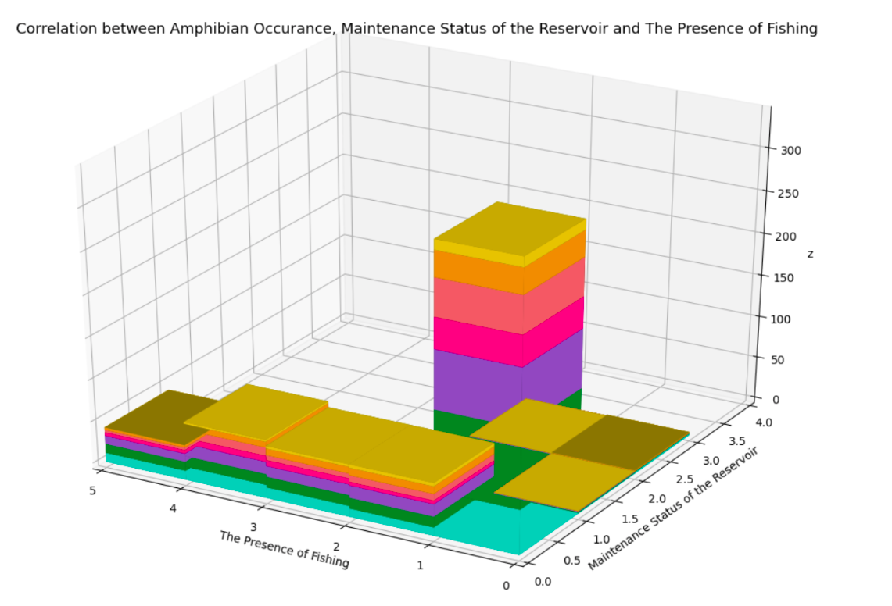
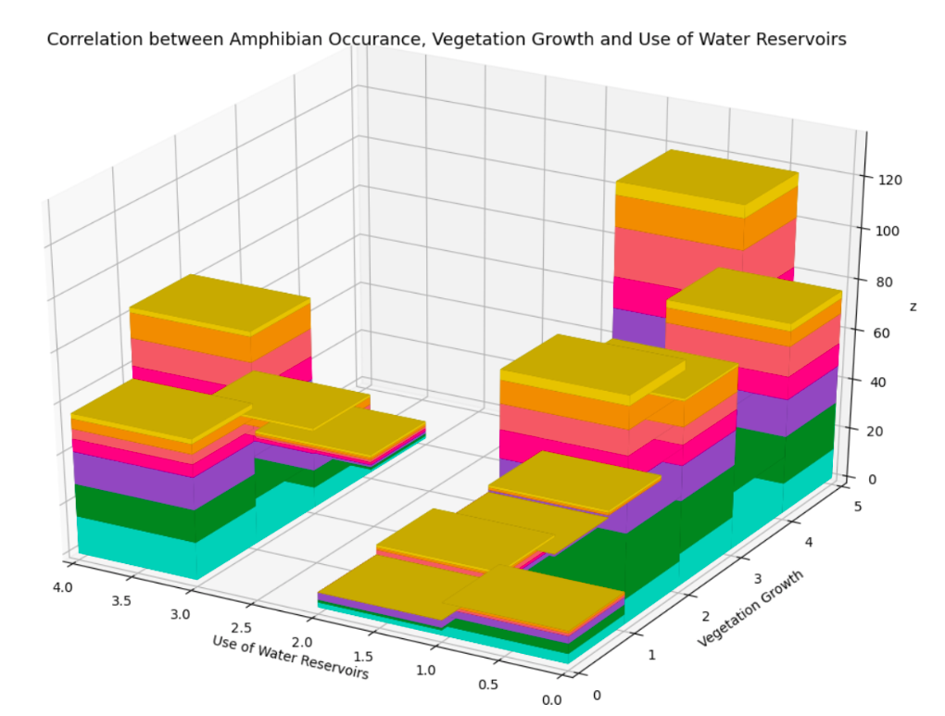
Data Set Analyzation
No attributes that can be used to easily predict the species occurrence

Slide 8
Machine Learning Model

Slide 9
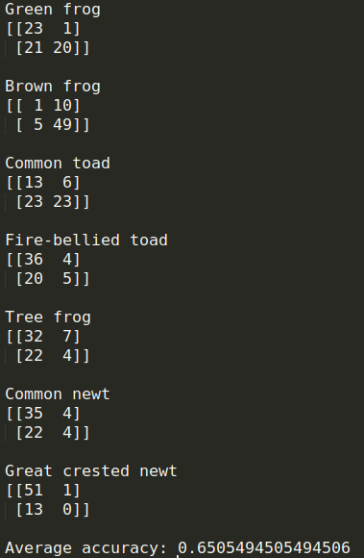
Support Vector Machine
True Negative | False Positive
False Negative | True Positive
Radial Basis Function kernel with the degree of 3
Accuracy of binary label data set: 65% with validation set | 67.7% with LOOCV
Accuracy of constructing 7 SVMs corresponding with each species: 65.27%

Slide 10
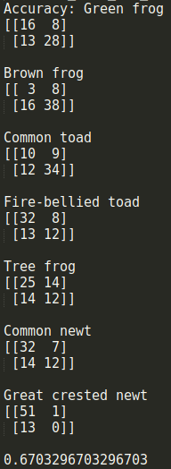
Artificial Neural Network
20 hidden layers with the size of 9
RELU for activation
Limited-memory BFGS solver for weight optimization
Accuracy: 67% with validation set | 64% with LOOCV

Slide 11
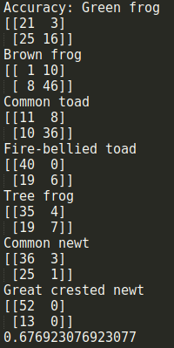
Decision Tree
Use gini for split criteria
Max depth of 4
Accuracy: 68.1% with validation set | 65.1% with LOOCV

Slide 12
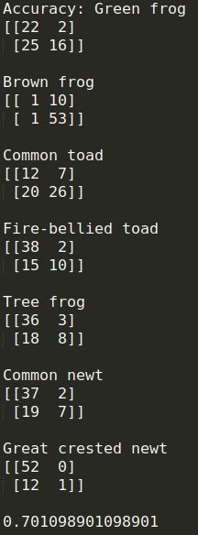
AdaBoost
Use the previous decision tree classifier for the base classifier
Learning rate: 0.72
Random state of 5
Accuracy: 70.1% with validation set | 67.7% with LOOCV

Slide 13
Confusion Matrix of Classifer with Bit Data (1 Classifier)
SVM
ANN
Decision Tree

Slide 14
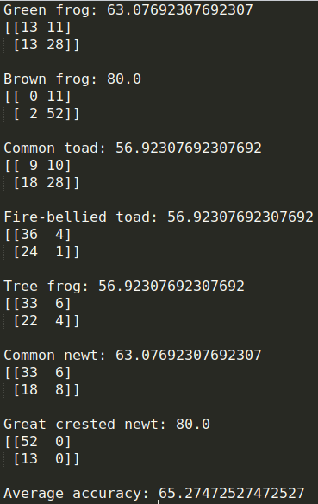
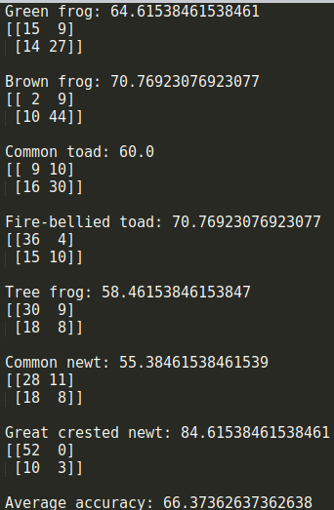
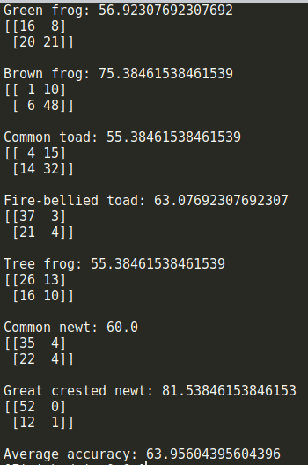
Confusion Matrix of Binary Classifers (7 Classifiers)
SVM
ANN
Decision Tree

Slide 15
Classifier | Validation Test | LOOCV
SVM | 65% | 67.7%
KNN | 64.6% | 64.1%
ANN | 67% | 64%
Decision Tree | 67.7% | 65.1%
AdaBoost | 70.1% | 67.7%
Overall Adaboost based on the decision tree has the best performance of 70.1%
Because of the uneven distribution and a really small instance, it is hard to get a better accuracy

Slide 16

Thanks!
Phuc Ngo, Beloit College
ngoph@beloit.com

